Slide 1
Procedure: Hand Gestures

Slide 2
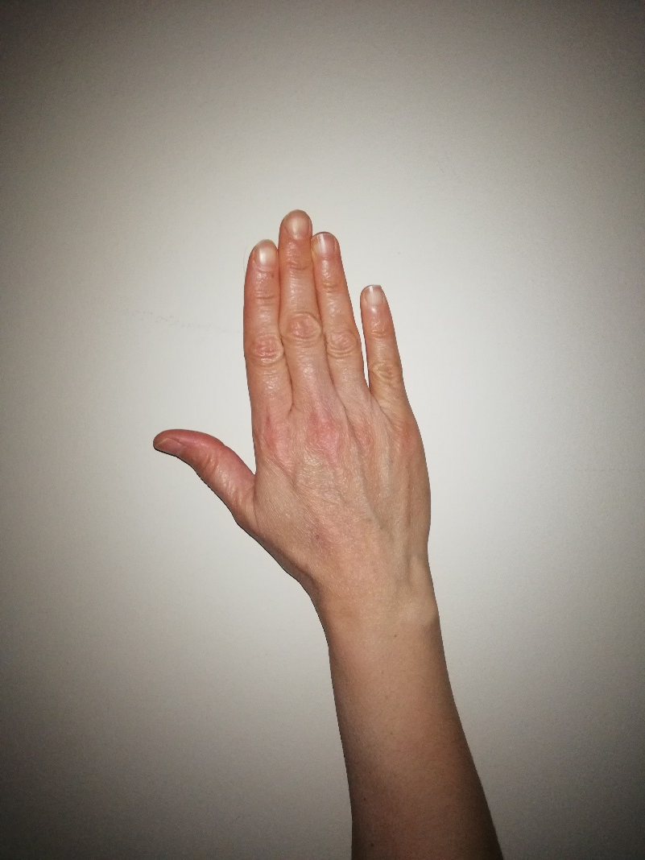
Hand should be at rest…
4
4 seconds…
3
2
1

Slide 3
Continue at rest position…
6
6 seconds…
5
4
3
2
1

Slide 4
Again at rest…
4
4 seconds…
3
2
1

Slide 5
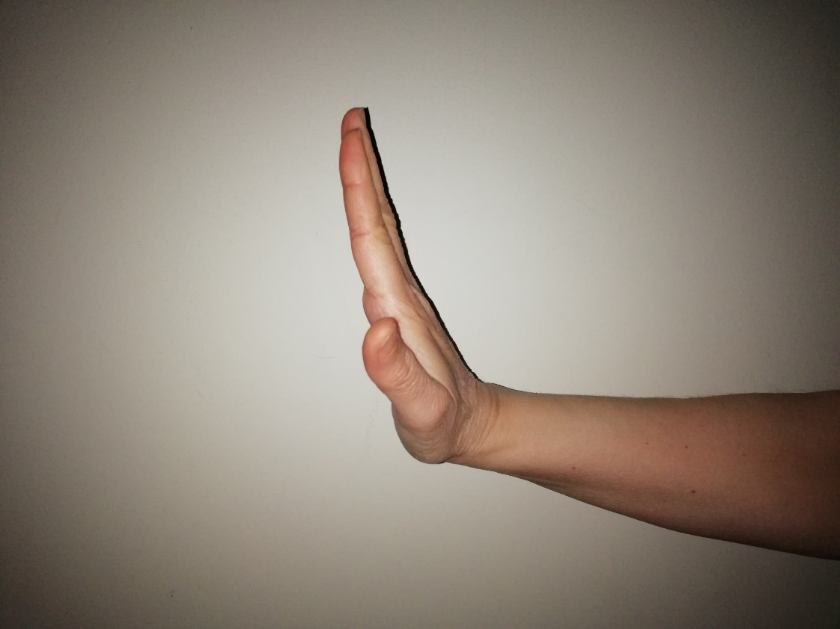
Extension
6
6 seconds…
5
4
3
2
1

Slide 6
Again at rest…
4
4 seconds…
3
2
1

Slide 7
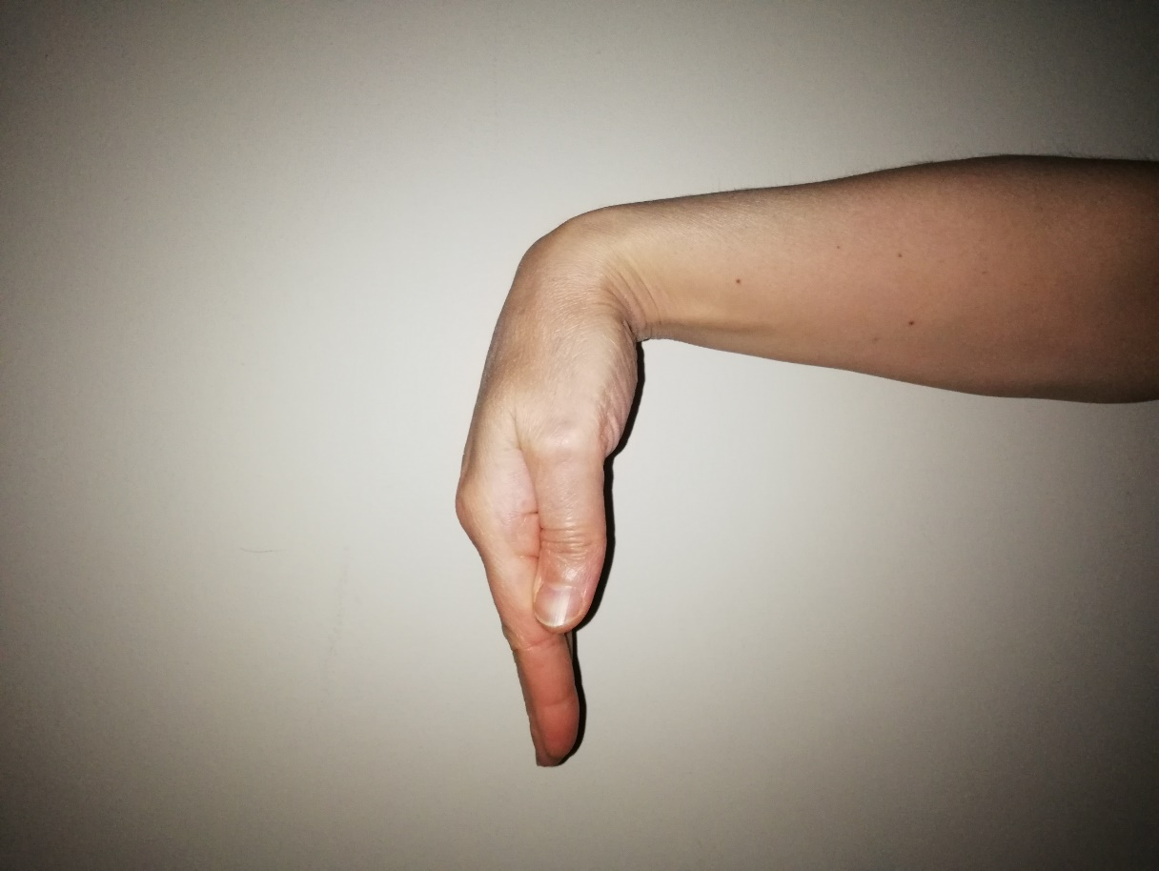
Flexion
6
6 seconds…
5
4
3
2
1

Slide 8
Again at rest…
4
4 seconds…
3
2
1

Slide 9
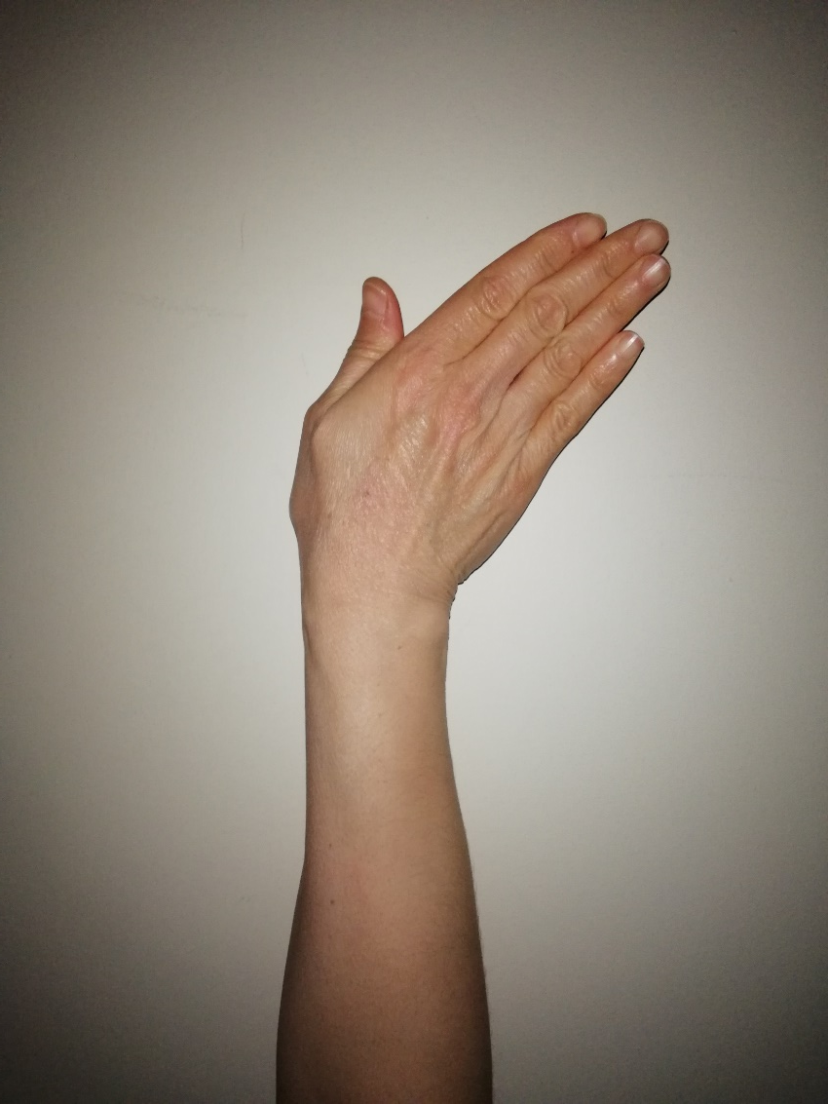
Ulnar Deviation
6
6 seconds…
5
4
3
2
1

Slide 10
Again at rest…
4
4 seconds…
3
2
1

Slide 11
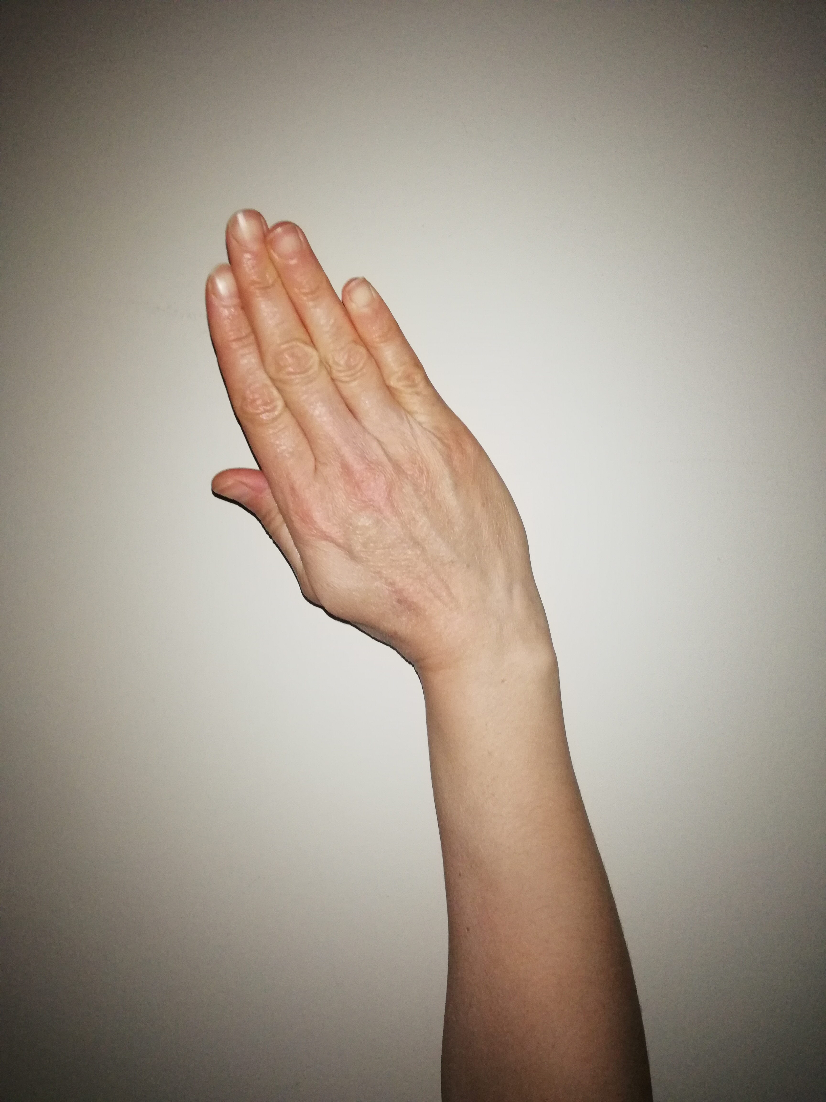
Radial Deviation
6
6 seconds…
5
4
3
2
1

Slide 12
Again at rest…
4
4 seconds…
3
2
1

Slide 13
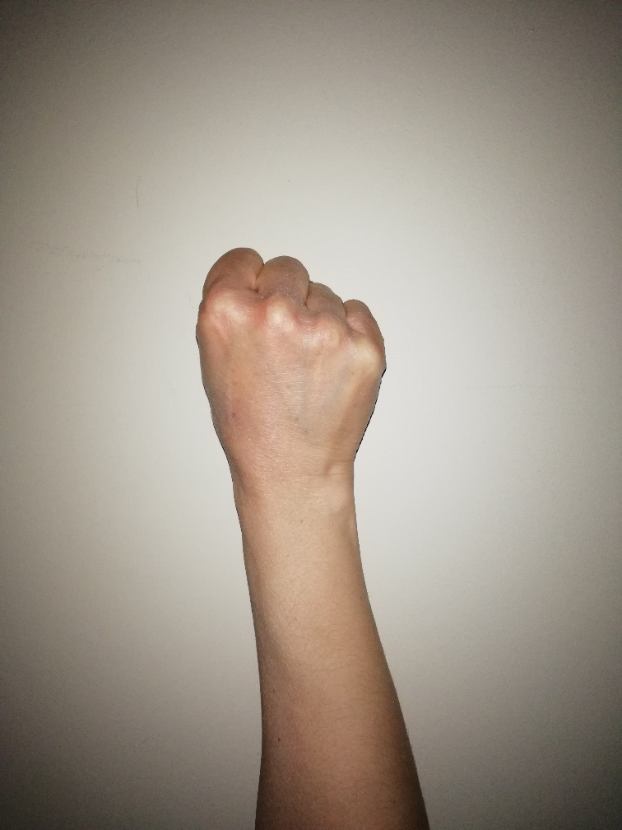
Grip
6
6 seconds…
5
4
3
2
1

Slide 14
Again at rest…
4
4 seconds…
3
2
1

Slide 15
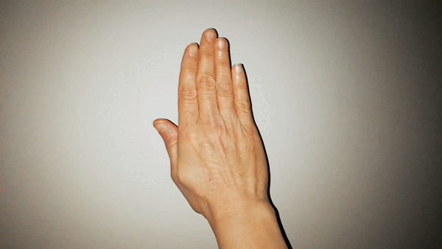
Abduction of all fingers
6
6 seconds…
5
4
3
2
1

Slide 16
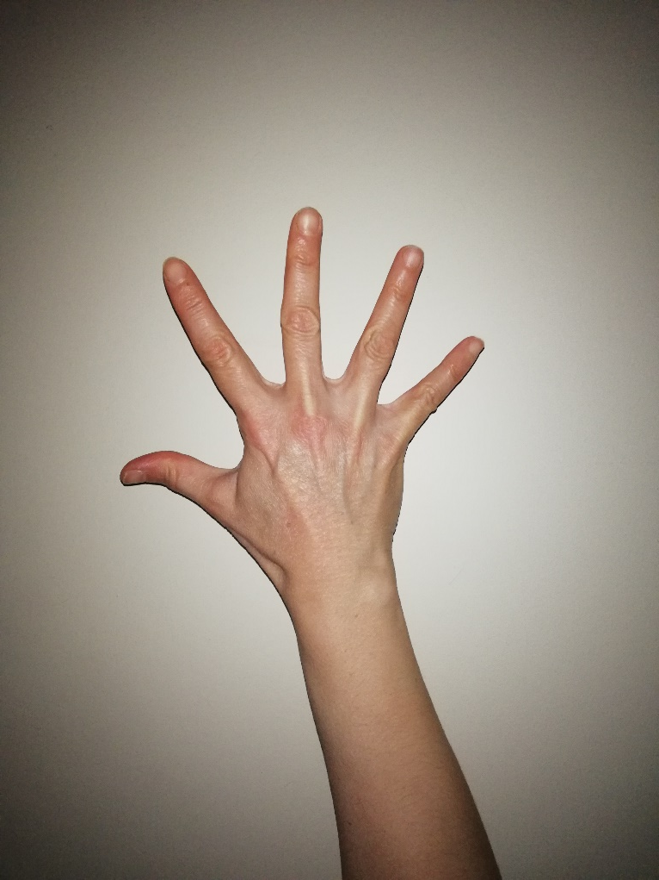
Continue abduction…
4
4 seconds…
3
2
1

Slide 17
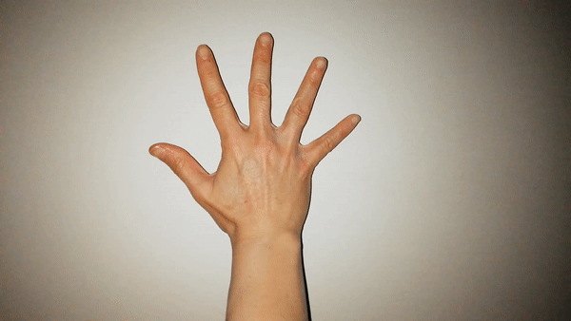
Adduction of all fingers
6
6 seconds…
5
4
3
2
1

Slide 18
At rest…
4
4 seconds…
3
2
1

Slide 19
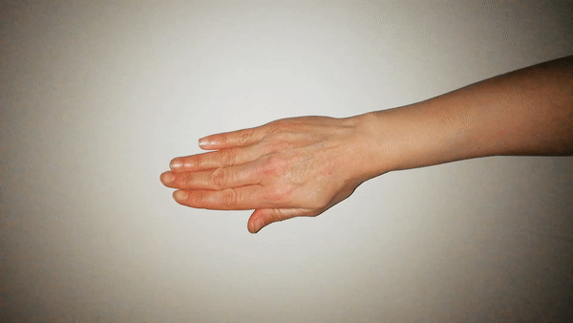
Supination
6
6 seconds…
5
4
3
2
1

Slide 20
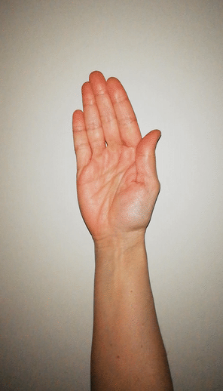
Continue supination…
4
4 seconds…
3
2
1

Slide 21
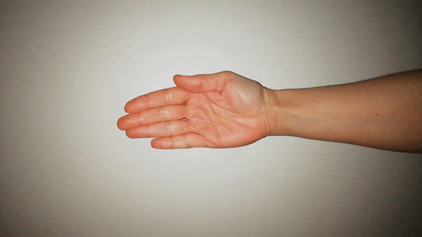
Pronation
6
6 seconds…
5
4
3
2
1

Slide 22
At rest…
4
4 seconds…
3
2
1

Slide 23

First cycle is completed

Slide 24
2. PART

Slide 25
Hand should be at rest…
4
4 seconds…
3
2
1

Slide 26
Continue at rest position…
6
6 seconds…
5
4
3
2
1

Slide 27
Again at rest…
4
4 seconds…
3
2
1

Slide 28
Extension
6
6 seconds…
5
4
3
2
1

Slide 29
Again at rest…
4
4 seconds…
3
2
1

Slide 30
Flexion
6
6 seconds…
5
4
3
2
1

Slide 31
Again at rest…
4
4 seconds…
3
2
1

Slide 32
Ulnar Deviation
6
6 seconds…
5
4
3
2
1

Slide 33
Again at rest…
4
4 seconds…
3
2
1

Slide 34
Radial Deviation
6
6 seconds…
5
4
3
2
1

Slide 35
Again at rest…
4
4 seconds…
3
2
1

Slide 36
Grip
6
6 seconds…
5
4
3
2
1

Slide 37
Again at rest…
4
4 seconds…
3
2
1

Slide 38
Abduction of all fingers
6
6 seconds…
5
4
3
2
1

Slide 39
Continue abduction…
4
4 seconds…
3
2
1

Slide 40
Adduction of all fingers
6
6 seconds…
5
4
3
2
1

Slide 41
At rest…
4
4 seconds…
3
2
1

Slide 42
Supination
6
6 seconds…
5
4
3
2
1

Slide 43
Continue supination…
4
4 seconds…
3
2
1

Slide 44
Pronation
6
6 seconds…
5
4
3
2
1

Slide 45
At rest…
4
4 seconds…
3
2
1

Slide 46
Second cycle is completed

Slide 47
3.PART

Slide 48
Hand should be at rest…
4
4 seconds…
3
2
1

Slide 49
Continue at rest position…
6
6 seconds…
5
4
3
2
1

Slide 50
Again at rest…
4
4 seconds…
3
2
1

Slide 51
Extension
6
6 seconds…
5
4
3
2
1

Slide 52
Again at rest…
4
4 seconds…
3
2
1

Slide 53
Flexion
6
6 seconds…
5
4
3
2
1

Slide 54
Again at rest…
4
4 seconds…
3
2
1

Slide 55
Ulnar Deviation
6
6 seconds…
5
4
3
2
1

Slide 56
Again at rest…
4
4 seconds…
3
2
1

Slide 57
Radial Deviation
6
6 seconds…
5
4
3
2
1

Slide 58
Again at rest…
4
4 seconds…
3
2
1

Slide 59
Grip
6
6 seconds…
5
4
3
2
1

Slide 60
Again at rest…
4
4 seconds…
3
2
1

Slide 61
Abduction of all fingers
6
6 seconds…
5
4
3
2
1

Slide 62
Continue abduction…
4
4 seconds…
3
2
1

Slide 63
Adduction of all fingers
6
6 seconds…
5
4
3
2
1

Slide 64
At rest…
4
4 seconds…
3
2
1

Slide 65
Supination
6
6 seconds…
5
4
3
2
1

Slide 66
Continue supination…
4
4 seconds…
3
2
1

Slide 67
Pronation
6
6 seconds…
5
4
3
2
1

Slide 68
At rest…
4
4 seconds…
3
2
1

Slide 69
Third cycle is completed

Slide 70
4.PART

Slide 71
Hand should be at rest…
4
4 seconds…
3
2
1

Slide 72
Continue at rest position…
6
6 seconds…
5
4
3
2
1

Slide 73
Again at rest…
4
4 seconds…
3
2
1

Slide 74
Extension
6
6 seconds…
5
4
3
2
1

Slide 75
Again at rest…
4
4 seconds…
3
2
1

Slide 76
Flexion
6
6 seconds…
5
4
3
2
1

Slide 77
Again at rest…
4
4 seconds…
3
2
1

Slide 78
Ulnar Deviation
6
6 seconds…
5
4
3
2
1

Slide 79
Again at rest…
4
4 seconds…
3
2
1

Slide 80
Radial Deviation
6
6 seconds…
5
4
3
2
1

Slide 81
Again at rest…
4
4 seconds…
3
2
1

Slide 82
Grip
6
6 seconds…
5
4
3
2
1

Slide 83
Again at rest…
4
4 seconds…
3
2
1

Slide 84
Abduction of all fingers
6
6 seconds…
5
4
3
2
1

Slide 85
Continue abduction…
4
4 seconds…
3
2
1

Slide 86
Adduction of all fingers
6
6 seconds…
5
4
3
2
1

Slide 87
At rest…
4
4 seconds…
3
2
1

Slide 88
Supination
6
6 seconds…
5
4
3
2
1

Slide 89
Continue supination…
4
4 seconds…
3
2
1

Slide 90
Pronation
6
6 seconds…
5
4
3
2
1

Slide 91
At rest…
4
4 seconds…
3
2
1

Slide 92
Fourth cycle is completed

Slide 93
5.PART

Slide 94
Hand should be at rest…
4
4 seconds…
3
2
1

Slide 95
Continue at rest position…
6
6 seconds…
5
4
3
2
1

Slide 96
Again at rest…
4
4 seconds…
3
2
1

Slide 97
Extension
6
6 seconds…
5
4
3
2
1

Slide 98
Again at rest…
4
4 seconds…
3
2
1

Slide 99
Flexion
6
6 seconds…
5
4
3
2
1

Slide 100
Again at rest…
4
4 seconds…
3
2
1

Slide 101
Ulnar Deviation
6
6 seconds…
5
4
3
2
1

Slide 102
Again at rest…
4
4 seconds…
3
2
1

Slide 103
Radial Deviation
6
6 seconds…
5
4
3
2
1

Slide 104
Again at rest…
4
4 seconds…
3
2
1

Slide 105
Grip
6
6 seconds…
5
4
3
2
1

Slide 106
Again at rest…
4
4 seconds…
3
2
1

Slide 107
Abduction of all fingers
6
6 seconds…
5
4
3
2
1

Slide 108
Continue abduction…
4
4 seconds…
3
2
1

Slide 109
Adduction of all fingers
6
6 seconds…
5
4
3
2
1

Slide 110
At rest…
4
4 seconds…
3
2
1

Slide 111
Supination
6
6 seconds…
5
4
3
2
1

Slide 112
Continue supination…
4
4 seconds…
3
2
1

Slide 113
Pronation
6
6 seconds…
5
4
3
2
1

Slide 114
At rest…
4
4 seconds…
3
2
1

Slide 115
Fifth cycle is completed

Slide 116
Finish

